Slide 1
Banking Application in Java
(Console Based Application)

Slide 2
ABSTRACT
The Project “Banking Application in java” is console based java application . This is somewhat complex Java project which consists of five different classes and is a console-based application. When the system starts the user is prompted with an Account number and password. After entering the details successfully, the functionalities are unlocked and functionalities provide by this application are like Check Balance, Deposit Money , Withdraw amount and exit..
We Can even use this code for web application by adding some additional features Using JDBC and servlets . We are developing Basic code for Banking Application using eclipse. Additionally, this project is to provide additional features to the user’s workspace that are not available in a traditional banking project.

Slide 3
Objective:
Development of a console based banking application which provides operations
Like check balance , deposit , withdraw and exit the console after completion.
This can only be prompted to the user when they enter valid login credentials.
Benefits:
Time saving.
Less paper work.
Cost efficient
Convinience and flexibility

Slide 4
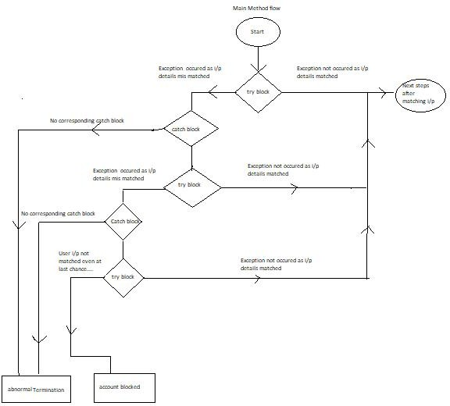
Architecture

Slide 5
Tools Used :
Java Programming
Eclipse IDLE

Slide 6
Data Insertion :
We don’t require much info externally for the this project we just take Account number and password as input from the console and perform operation according to the user specification.

Slide 7
Problem Statement:
This project is to provide additional features to the user’s workspace that are not available in a traditional banking project.it provide some basic functionalities like check balance , withdraw,deposit money and exit console

Slide 8
Proposed Solution:
The solution proposed here is an console based application using java without manually going to bank .It provide basic functionality based on the user requirement but this solution is limited to the user console using eclipse.

Slide 9
Further Improvements:
Our project is limited to only one user working only with the help of console input .where here we are not using database to store multiple records of the user and provide service to the multiple user based one the user request .we can even develop this project by using JDBC and we make this project more advance making it web based application using servlets.

Slide 10
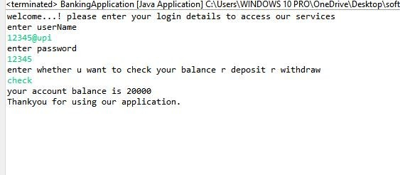
OUTPUT:

Slide 11
Conclusion:
This Basic console based application which help to perform some basic banking applications like Check Balance , Withdrawing Money and Deposition is efficient and very helpful to the user.

